Slide 1
Book Recommendation System
Project

Slide 2
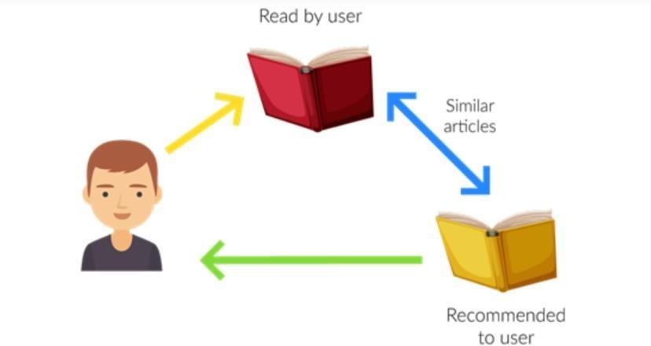
BOOK RECOMMENDATION SYSTEM
Recommendation systems are widely used today to recommend relevant products to users based on their interests. Every consumer Internet company like Netflix, YouTube etc. requires a recommendation system for efficient functioning.
A Book Recommendation System is a type of recommendation system where we have to recommend similar books to the reader based on his/her interest.

Slide 3

PROBLEM STATEMENT
Given the Book-Crossing dataset that comprises of three files-Users, Books and Ratings. The aim of this project is to build different types of book recommendation systems.

Slide 4





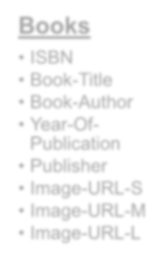
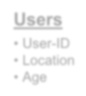
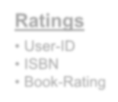
DATA SUMMARY
Books
ISBN
Book-Title
Book-Author
Year-Of- Publication
Publisher
Image-URL-S
Image-URL-M
Image-URL-L
Users
User-ID
Location
Age
Ratings
User-ID
ISBN
Book-Rating

Slide 5

METHODOLOGY
Data- Preprocessing
EDA
Building Models
Evaluation

Slide 6
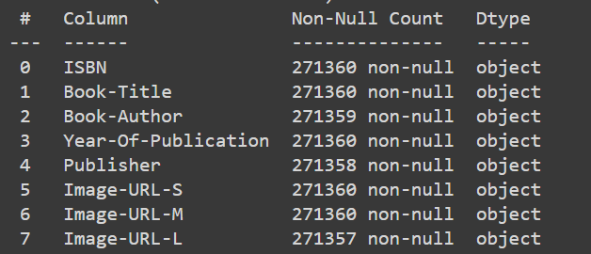
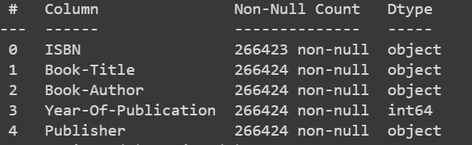


PRE-PROCESSING: BOOKS DATASET
Removed the columns “Image-URL-S”, “Image-URL-M” and “Image-URL-
L” which do not provide any information for analysis.
Replaced the null values in “Publisher” and “Book-Author” by “Unknown”
Corrected misplaced entries in the columns “Book-Title”, “Book-Author”, “Year-Of-Publication” and “Publisher”.
Imputed invalid entries in the columns “Year of Publication” with mode.
Cleaned “ISBN” - Converted into uppercase.
Duplicates removal.

Slide 7
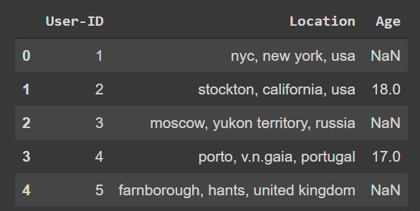
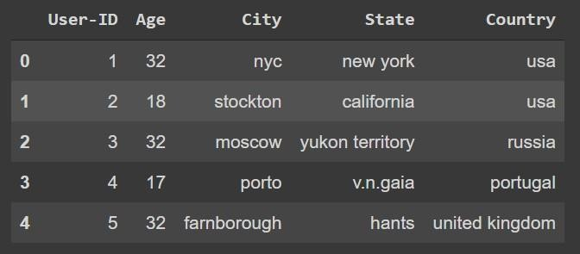


PRE-PROCESSING: USERS DATASET
Cleaned Location column and separated City, state and country.
Imputed invalid entries and null values in the column Age with median.
Duplicates removal.

Slide 8
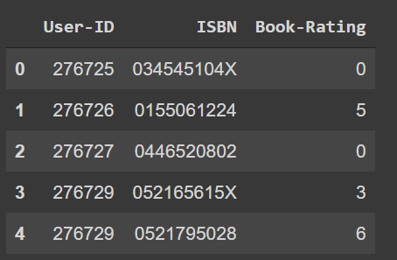
PRE-PROCESSING: RATINGS DATASET
Cleaned ISBN- Converted into uppercase, removed special characters.
Removed duplicates.

Slide 9




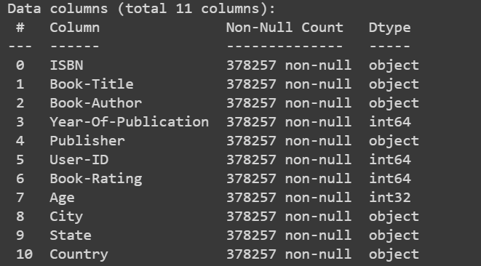
FINAL DATASET
BOOKS
RATINGS
USERS
FINAL
DATASET
We consider only explicit ratings for this project. So we remove 0 ratings.

Slide 10
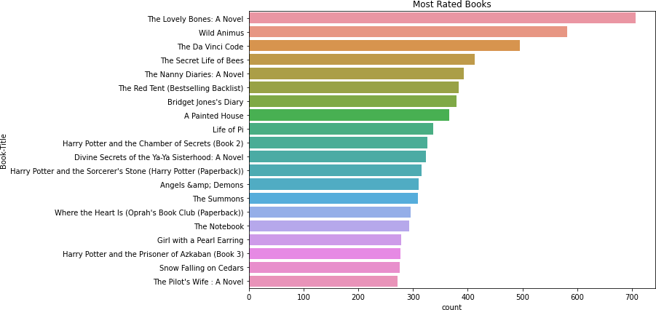
MOST RATED BOOKS

Slide 11
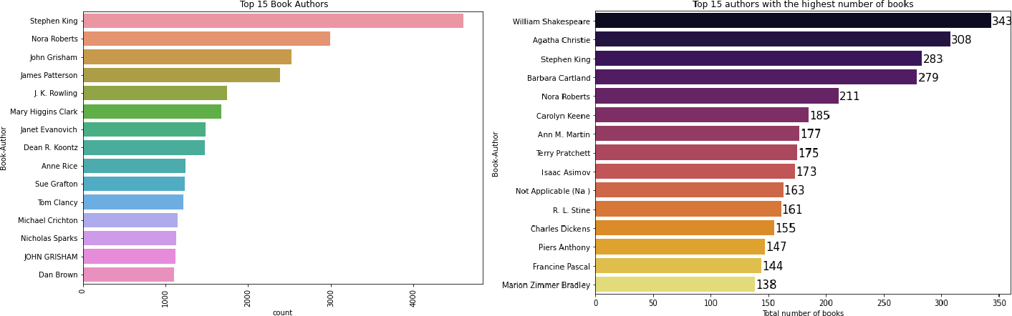
TOP BOOK AUTHORS

Slide 12
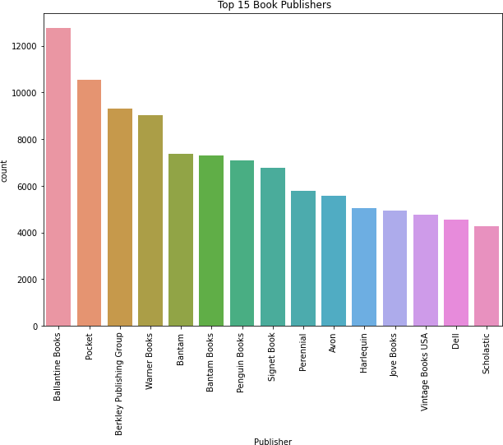
TOP 15BOOK PUBLISHERS

Slide 13
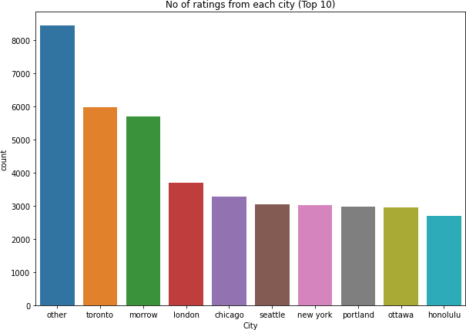
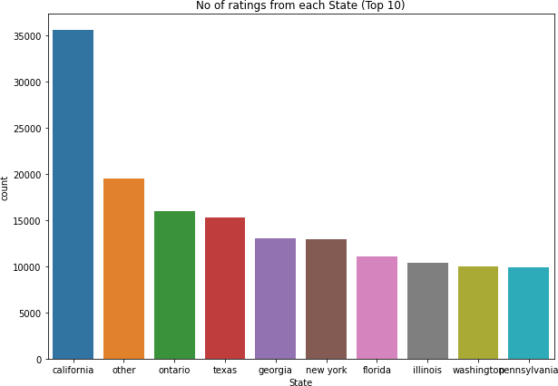
CITY AND STATE-BASED RATINGS ANALYSIS

Slide 14
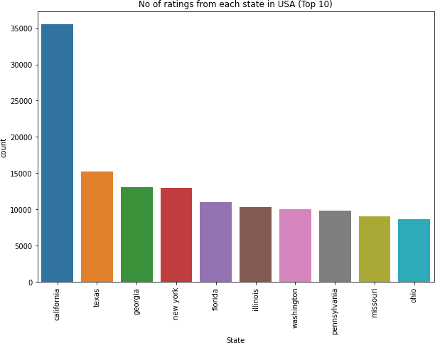
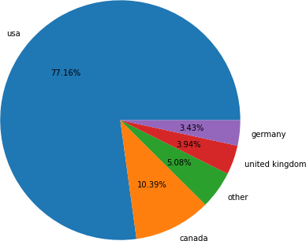
COUNTRY-BASED RATINGS ANALYSIS

Slide 15
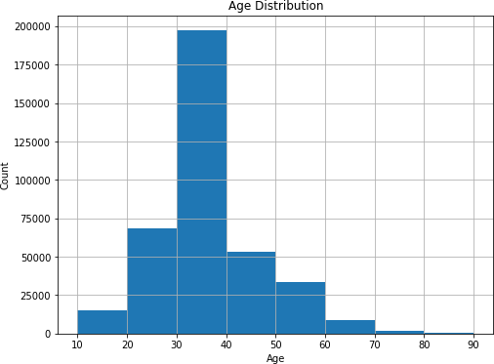
AGE DISTRIBUTION

Slide 16
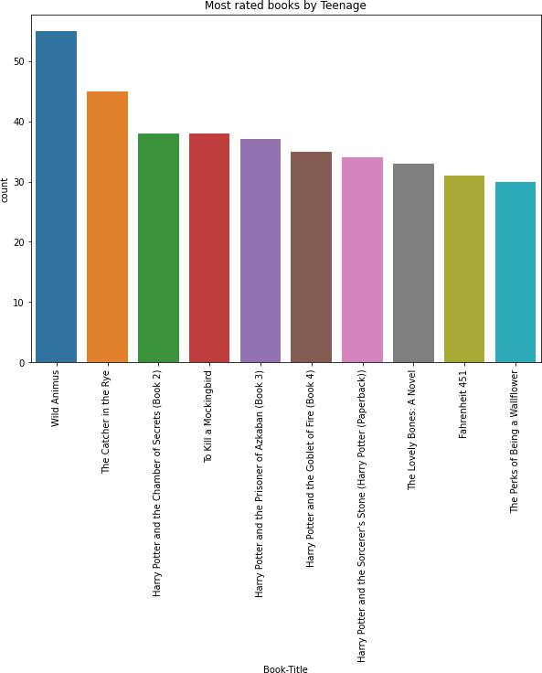
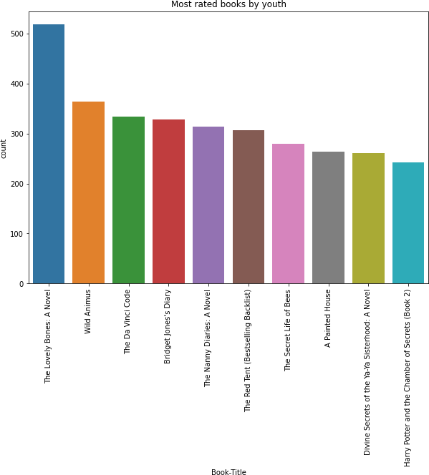
MOST RATED BOOKS BY TEENAGE AND YOUTH

Slide 17
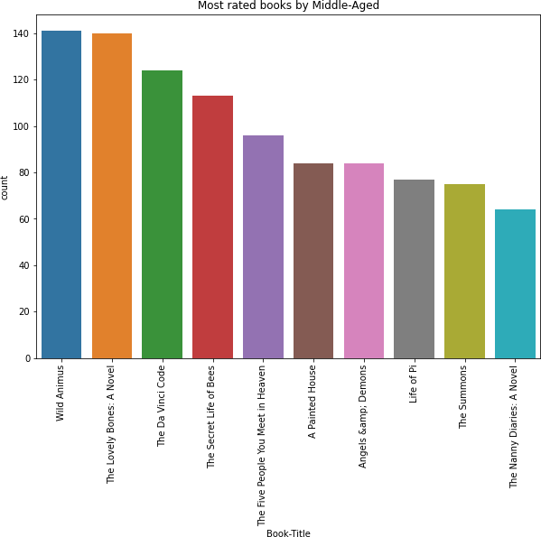
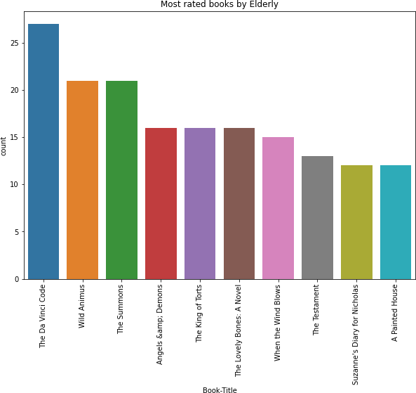
MOST RATED BOOKS BY MIDDLE-AGED AND ELDERLY

Slide 18
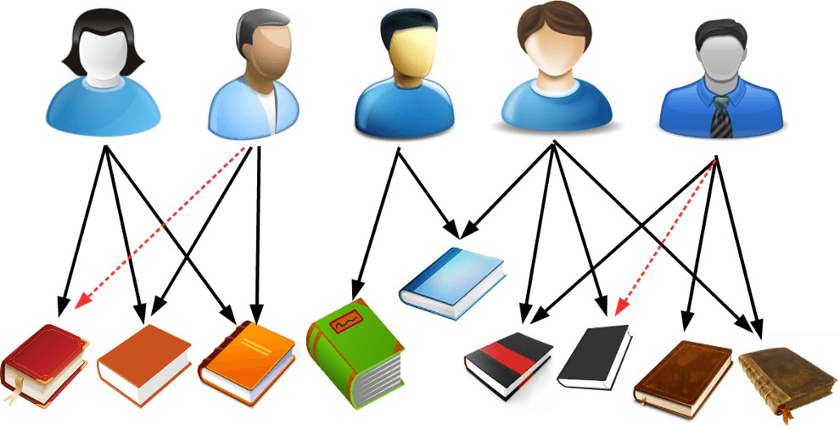
RECOMMENDATION SYSTEMS
Popularity-Based Recommendation System
Simple Recommendation System
Author-Based Recommendation System
Collaborative Recommendation - k-Nearest Neighbours
Collaborative Recommendation- Singular Value Decomposition

Slide 19
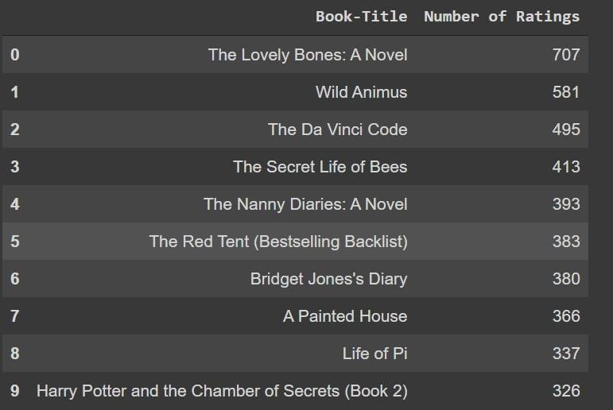
POPULARITY BASED RECOMMENDATION SYSTEM
It is a type of recommendation system which works on the principle of popularity and or anything which is in trend.

Slide 20

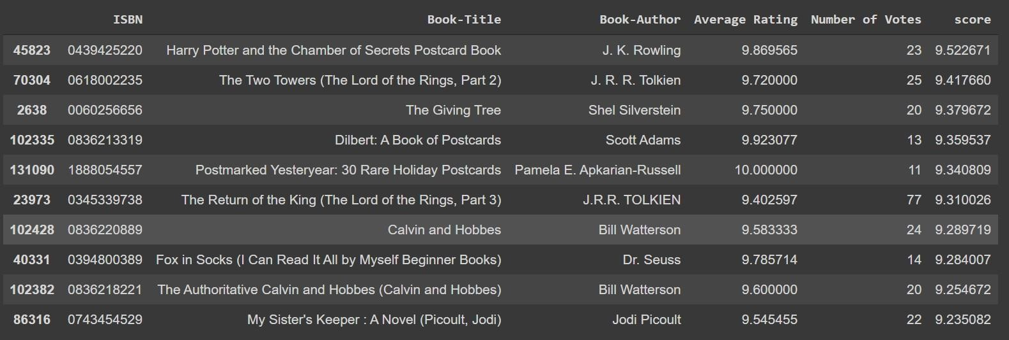
SIMPLE RECOMMENDATION SYSTEM
It is a type of recommendation system which works on the principle of weighted rating.
𝑅= Average rating for each book
𝑣 = Number of Votes for a particular book
𝑐 = Mean vote across the whole
report
𝑚 = Minimum number of votes required to be in the chart

Slide 21
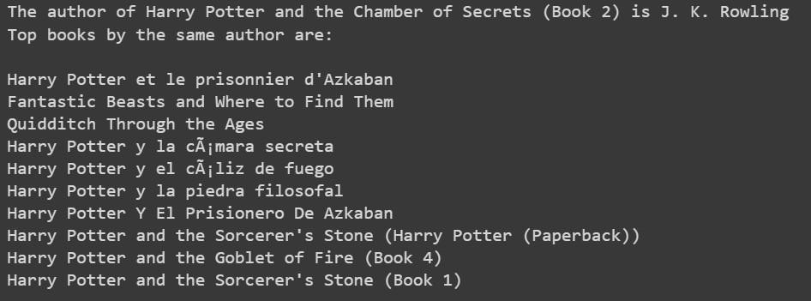
AUTHOR-BASED RECOMMENDATION SYSTEM
Input Book: Harry Potter and the Chamber of Secrets (Book 2)
Number of Recommendations:10

Slide 22
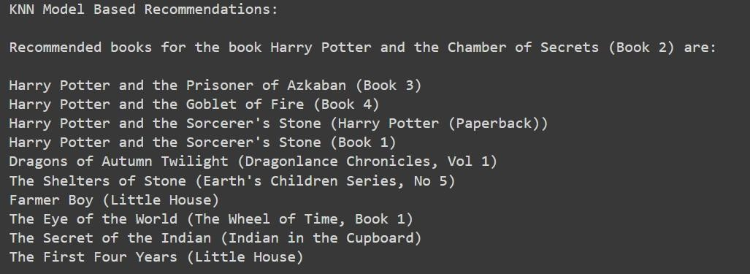
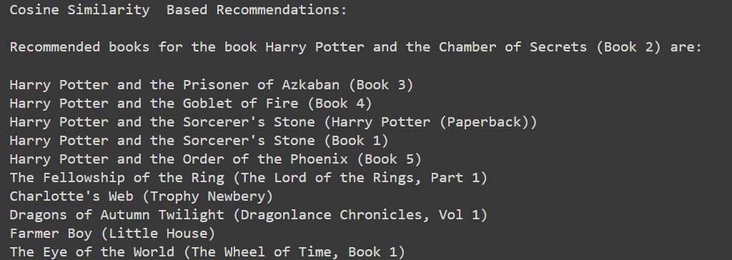
COLLABORATIVE RECOMMENDATION SYSTEM- K NEAREST NEIGHBOURS
Input Book: Harry Potter and the Chamber of Secrets (Book 2)
Number of Recommendations:10
Metric=Minkowski Distance
Metric=Cosine Similarity

Slide 23
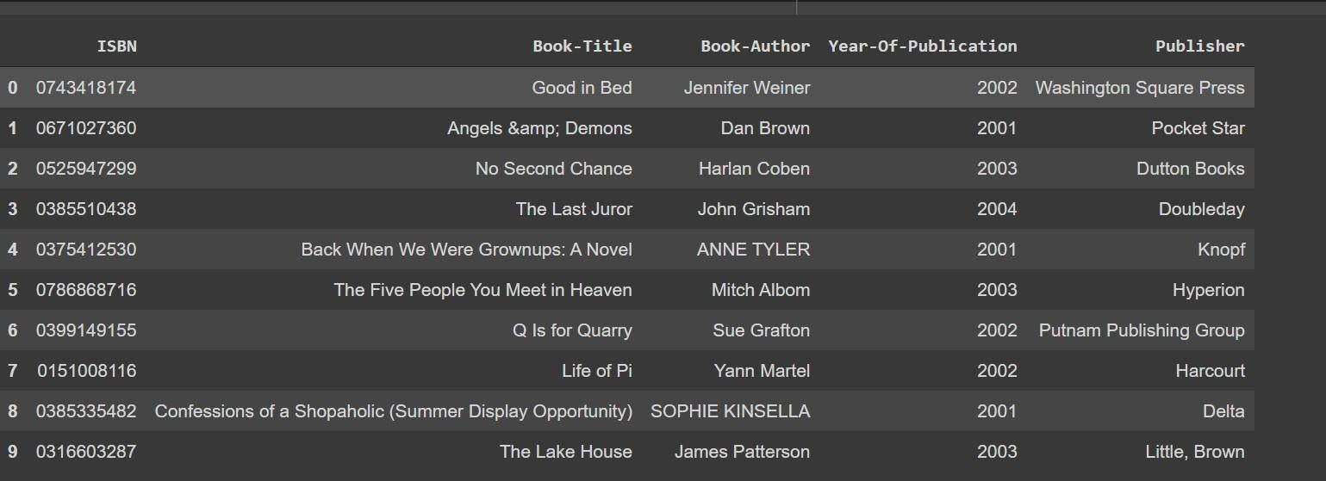
COLLABORATIVE FILTERING-SINGULAR VALUE DECOMPOSITION

Slide 24
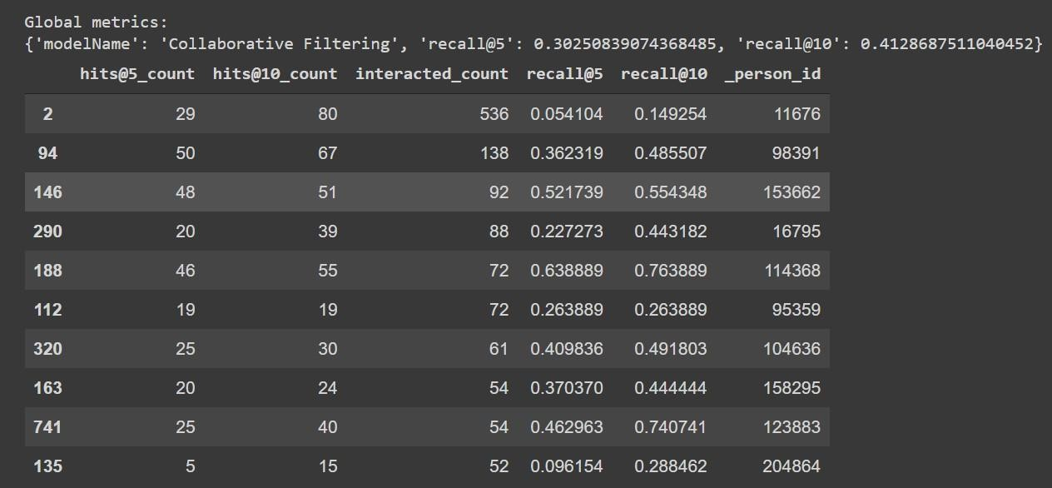
EVALUATION

Slide 25
CONCLUSION
The most rated books are The Lovely Bones: A Novel and Wild Animus.
Top book author with respect to the number of ratings is Stephan King and with respect to the number of books written is William Shakespeare.
Top publishers on the basis of the number of ratings received for their books
are Ballantine Books and Pocket.
Majority of the readers are of the age bracket 30–40 and most of them are from the countries USA, Texas and Georgia.
Wild animus is one of the most rated books irrespective of the age.
We built 5 types of recommendation systems and did evaluation for one of
them.
After evaluation for Collaborative-Model Based Recommendation system, we got a recall@5 of 30% and recall@10 of 41%.

Slide 26
THANK YOU

